Slide 1
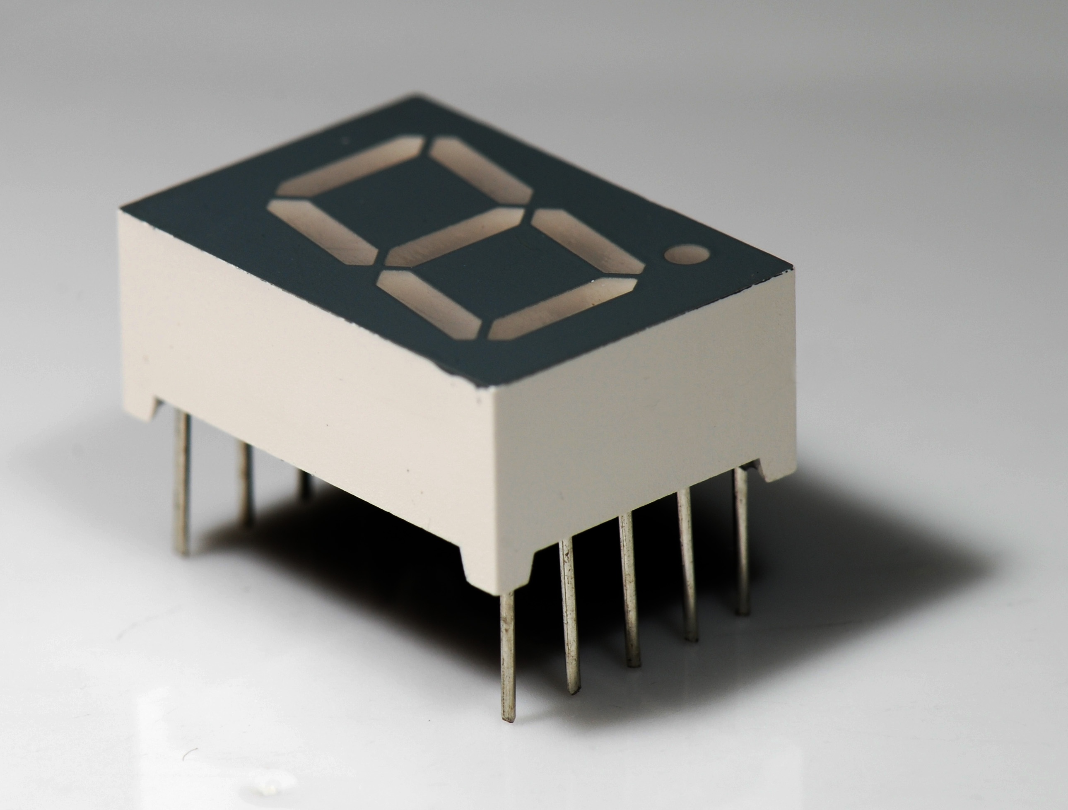

7-Segment display
What are they?

Slide 2
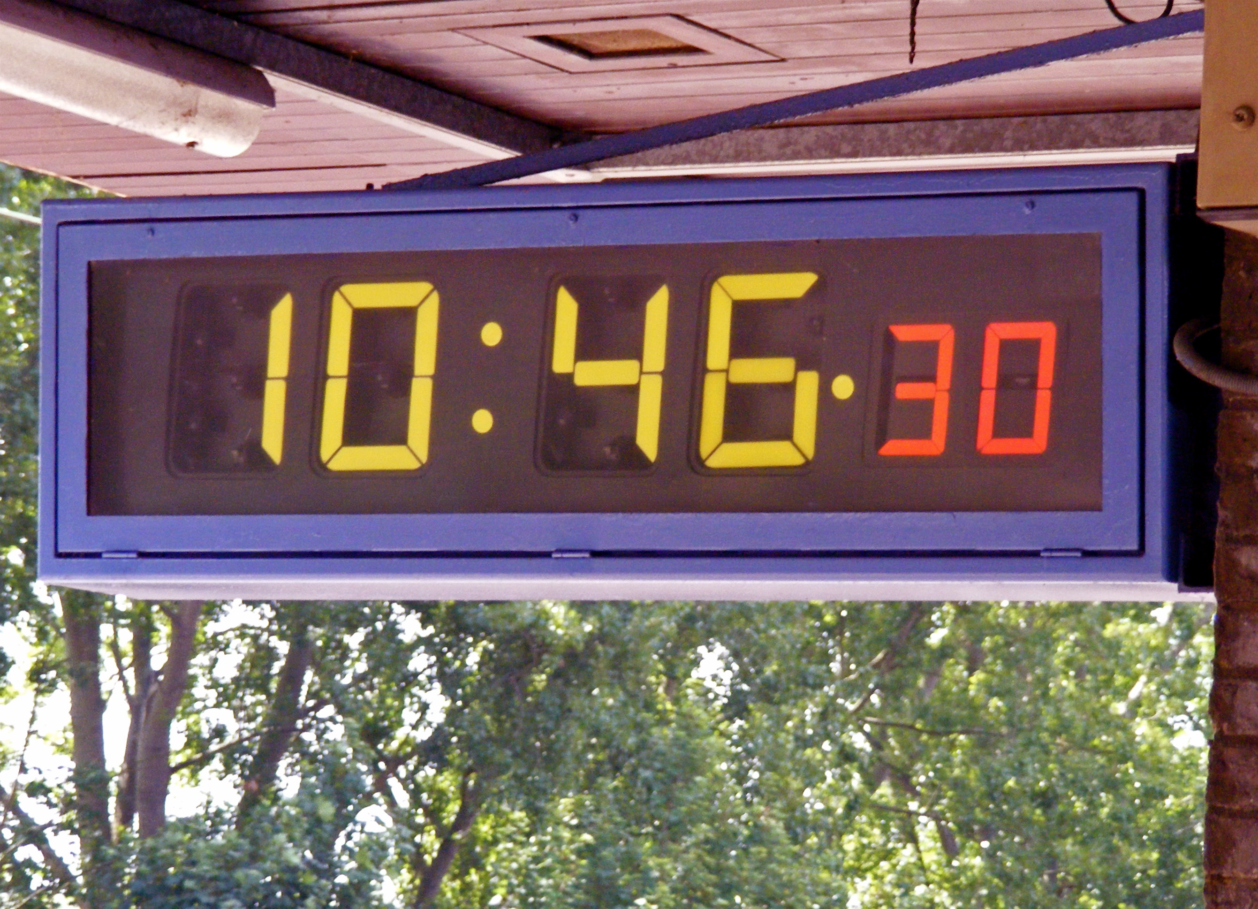
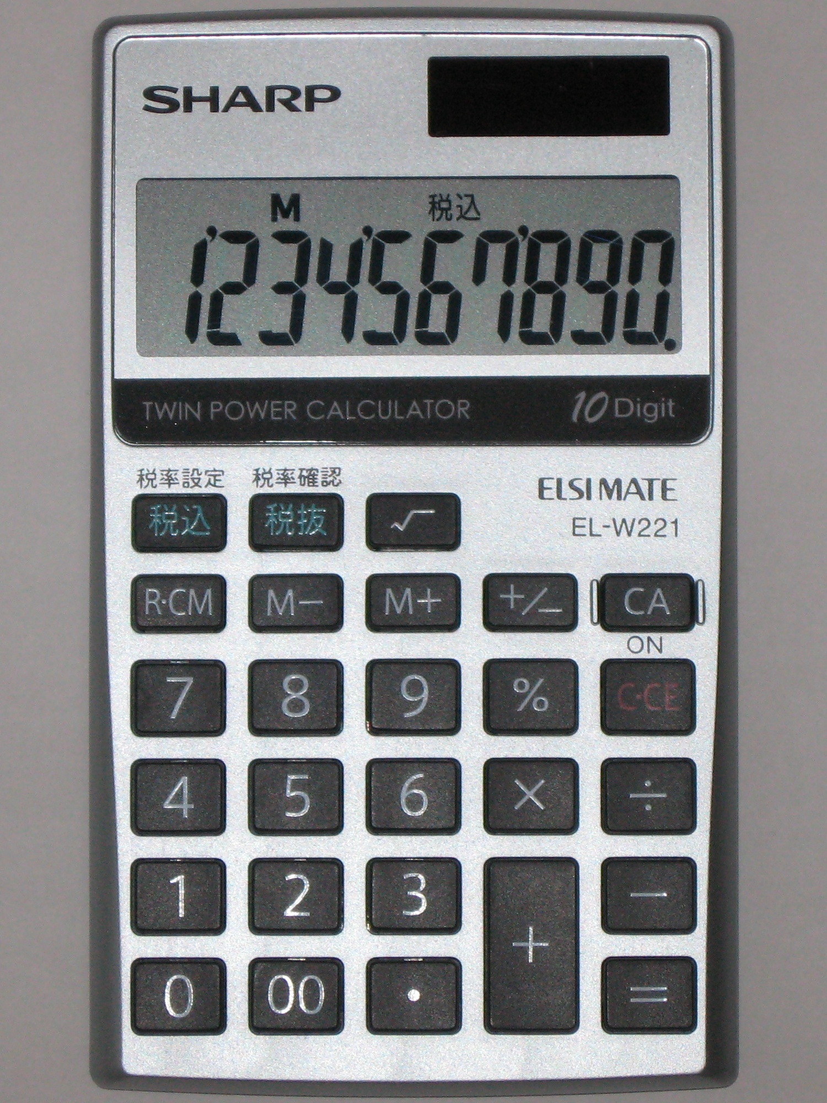
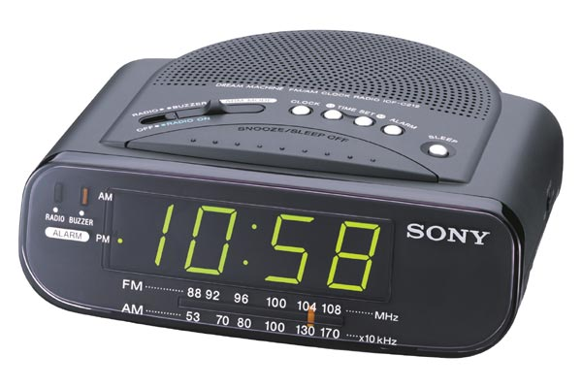
Where are they used?

Slide 3
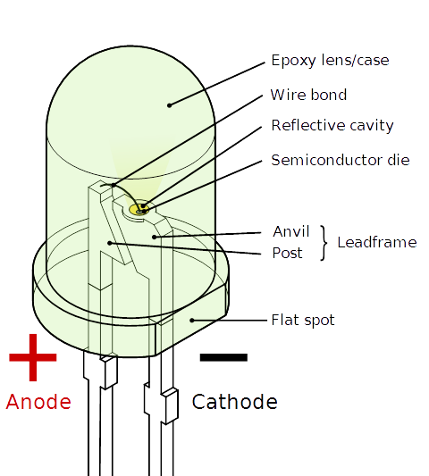
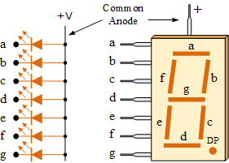
How do they work?

Slide 4
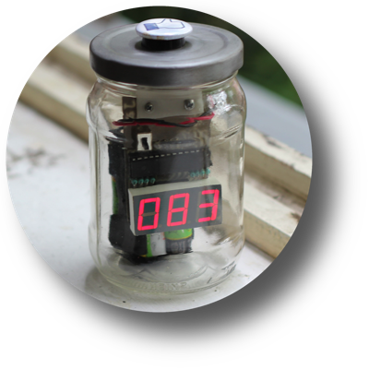
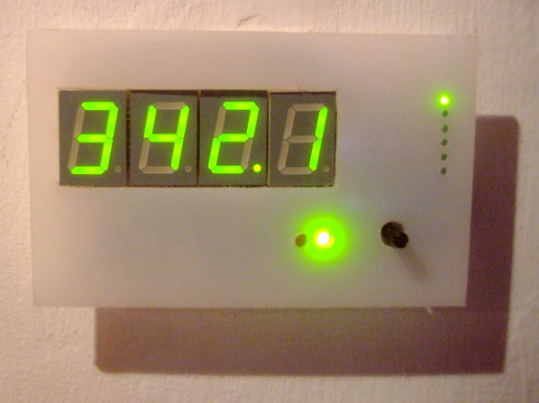
How can I use one in my project?

Slide 5
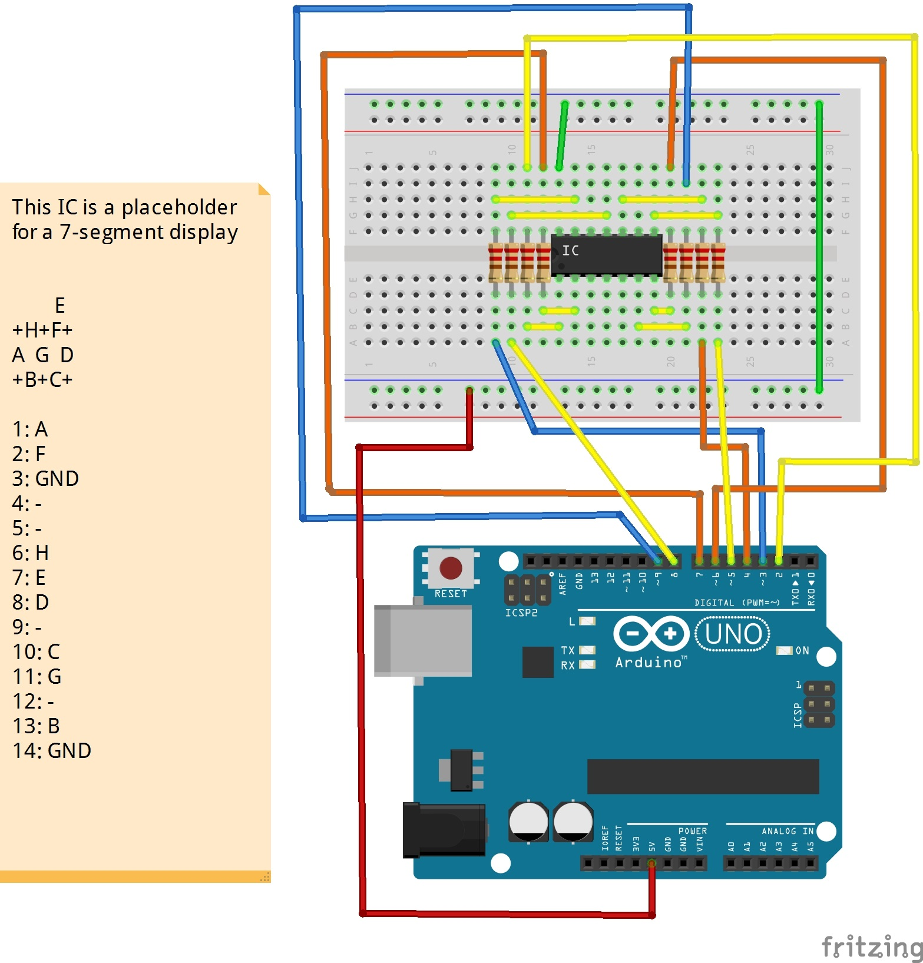
Wiring the display

Slide 6
Writing the code to display No.1
Truth table
Decimal Digitxx | Individual cells illuminated
 | A | B | C | D | E | F | G
0 | x | x | x | x | x | x
1 |  | x | x
2 | x | x |  | x | x |  | x
3 | x | x | x | x |  |  | x
4 |  | x | x |  |  | x | x
5 | x |  | x | x |  | x | x
6 | x |  | x | x | x | x | x
7 | x | x | x
8 | x | x | x | x | x | x | x
9 | x | x | x | x |  | x | x

Slide 7
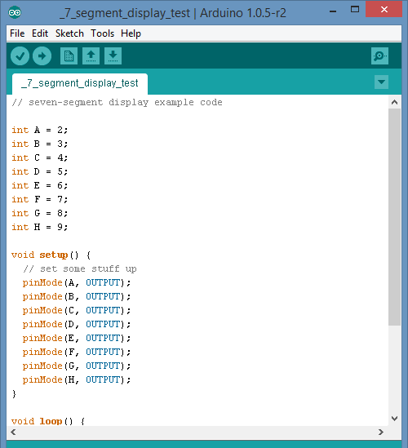
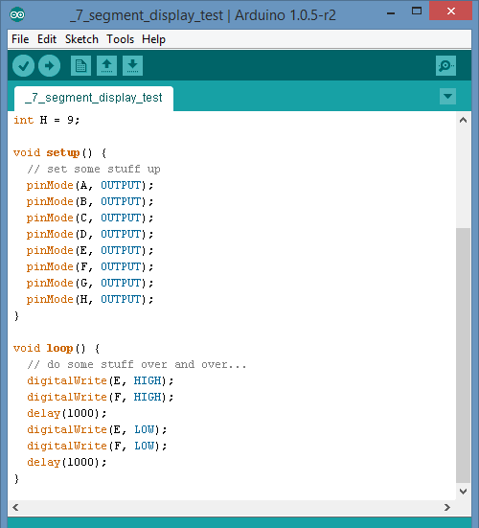

Slide 8
Cleaning up the code (functions)

Slide 10
attributions
"Seven segment 02 Pengo". Licensed under Creative Commons Attribution-Share Alike 3.0 via Wikimedia Commons - http://commons.wikimedia.org/wiki/File:Seven_segment_02_Pengo.jpg#mediaviewer/File:Seven_segment_02_Pengo.jpg
"7 segment display labeled" by user:h2g2bob - Own work using Inkscape. Licensed under Creative Commons Attribution-Share Alike 3.0 via Wikimedia Commons - http://commons.wikimedia.org/wiki/File:7_segment_display_labeled.svg#mediaviewer/File:7_segment_display_labeled.svg
"7-segments Indicator" by Artur perm - Own work. Licensed under Public domain via Wikimedia Commons - http://commons.wikimedia.org/wiki/File:7-segments_Indicator.gif#mediaviewer/File:7-segments_Indicator.gif
"SHARP ELSIMATE EL-W221" by Spring days (talk) - Spring days (talk)による撮影. Licensed under Creative Commons Attribution-Share Alike 3.0-2.5-2.0-1.0 via Wikimedia Commons - http://commons.wikimedia.org/wiki/File:SHARP_ELSIMATE_EL-W221.jpg#mediaviewer/File:SHARP_ELSIMATE_EL-W221.jpg
"LED, 5mm, green (en)" by Inductiveload - Own work by uploader, drawn in Solid Edge and Inkscape.. Licensed under Public domain via Wikimedia Commons - http://commons.wikimedia.org/wiki/File:LED,_5mm,_green_(en).svg#mediaviewer/File:LED,_5mm,_green_(en).svg
“Like Jar promo” by Herman Kopinga. http://www.likejar.nl/LikeJar%20promo.png
OpenEnergyMonitor. http://openenergymonitor.org/emon/sites/default/files/display_1.jpg
Common anode 7-segment Display. http://www.electronics-tutorials.ws/articles/segment2.gif

